Slide 1
COMIC CHARACTERS portal

Slide 2
ABSTRACT
Comics is a medium that expresses narratives or other ideas using a series of still images, usually combined with text.
In this DBMS project we are trying to manage characters occurring in different franchises of comics in parts of the world.
Comic books are a big part of entertainment and they are present since early 19th century.
High leap taken by technology in 21st century has increased the no. of readers in all group of age.
Hence people rely on information from internet where data is highly inefficient and unorganized.

Slide 3
INTRODUCTION
In our Comic Characters Portal(CCP)we are trying to organize data from various official sources under one name. CCP is a collection of data on fictional characters occurring in comic books in different franchises.
CCP is a one stop database where people can find information related to their favorite fictional characters. CCP is helpful as it organizes different fictional characters based on the publisher. It also provides statistics of characters and connections between different characters.

Slide 4
EXISTING SYSTEMS AND ITS DEMERITS
Present System available for such a Database provides with information on the fictional character alphabetically which is inefficient and unorganized and they don’t provide with enough information on the fictional characters and how they are related and their statistics.
Existing system also doesn’t provide with distinguished results of how fictional characters belong to different franchise and their country of origin.

Slide 5
PROPOSED SYSTEM
Proposed system was based on how we can overcome the demerits of the Existing system. Proposed System carefully organizes the information on fictional characters and gives a efficient result to users.
Objectives of Proposed System:
To provide quick information on the requested query.
To provide efficient and organized information.
To be able to easily hold large no. of records and easy maintenance.

Slide 6
Required Specification
SOFTWARE SPECIFICATION
HARDWARE SPECIFICATION
Operating System: Windows 7/ 8/ 10
Frontend: Python 3.x
Backend: MySQL
RAM: 3 – 4GB(min)
Processor: i3 or higher Intel chip

Slide 7
ENTITIES AND ATTRIBUTES
PUBLISHER: publisher_id, publisher_name, established, country
CADRE: team_id, created, name, no_of_ppl
PROTAGONIST: protagonist_id, publisher_id, team_id, name, alias, appearance, creator
ANTAGONIST: antagonist_id, publisher_id, team_id, protagonist_id, name, alias
STATS: protagonist_id, antagonist_id, power, speed, intelligence, combat, durability, strength

Slide 8
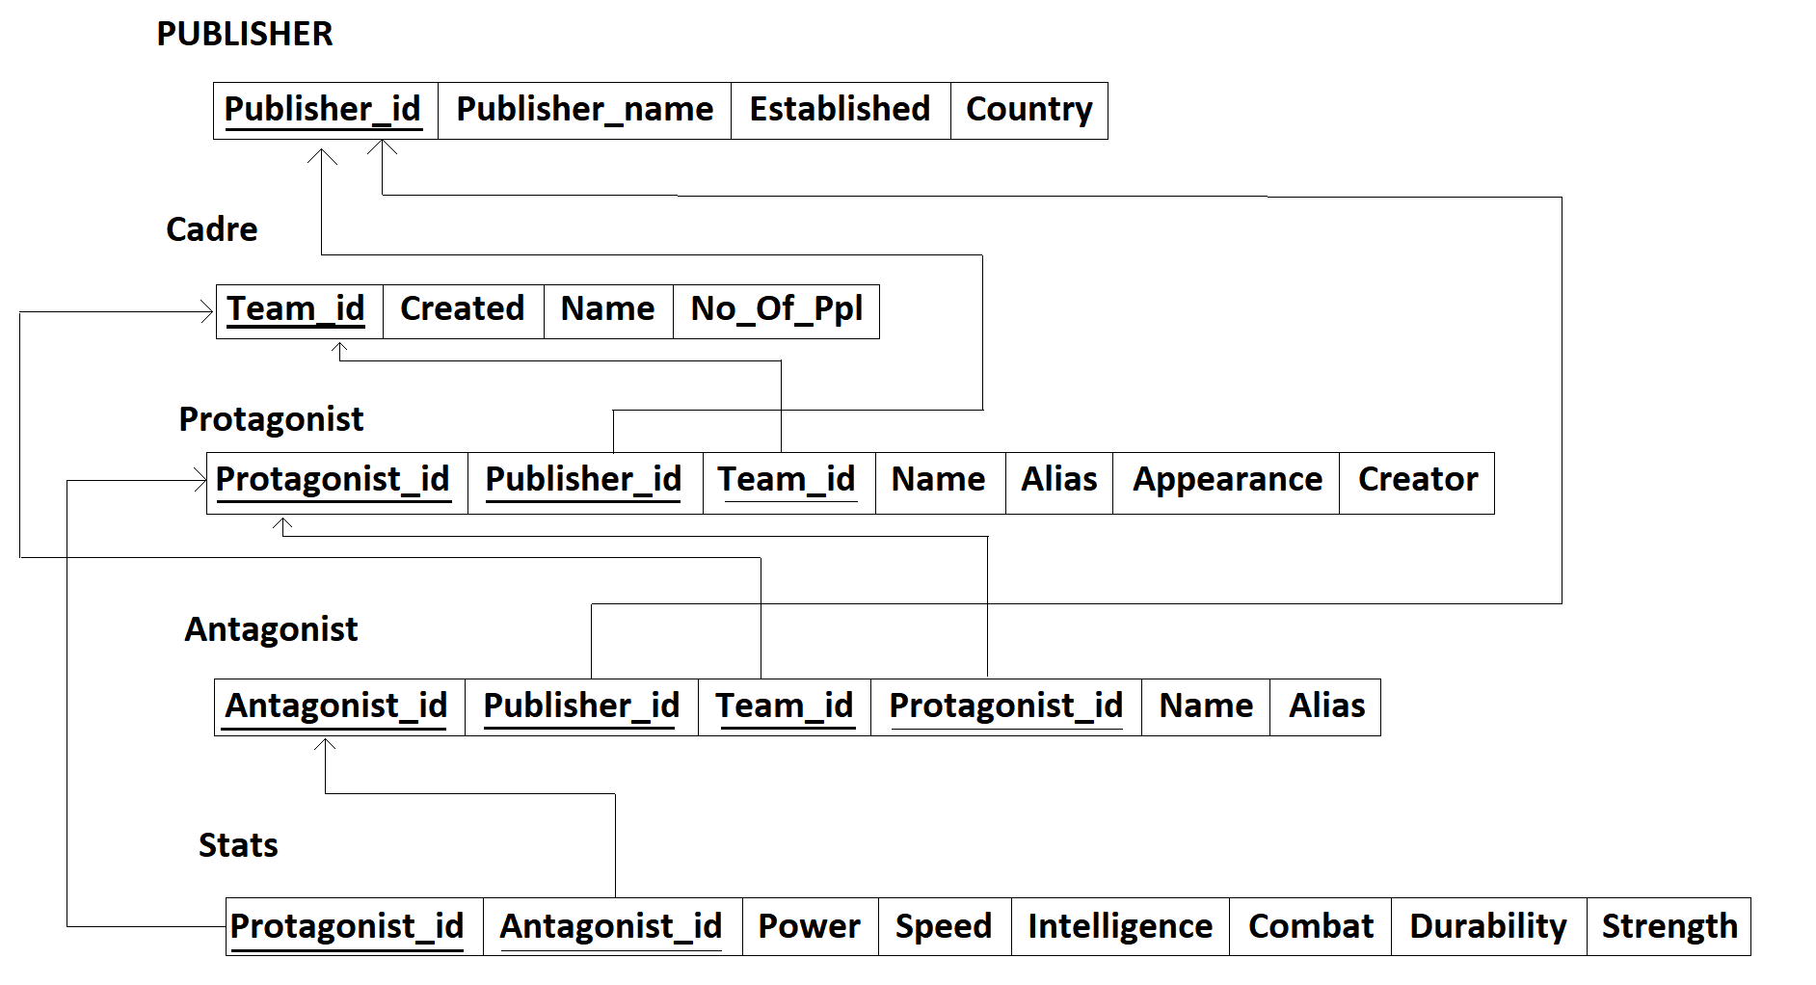
Schema diagram

Slide 9
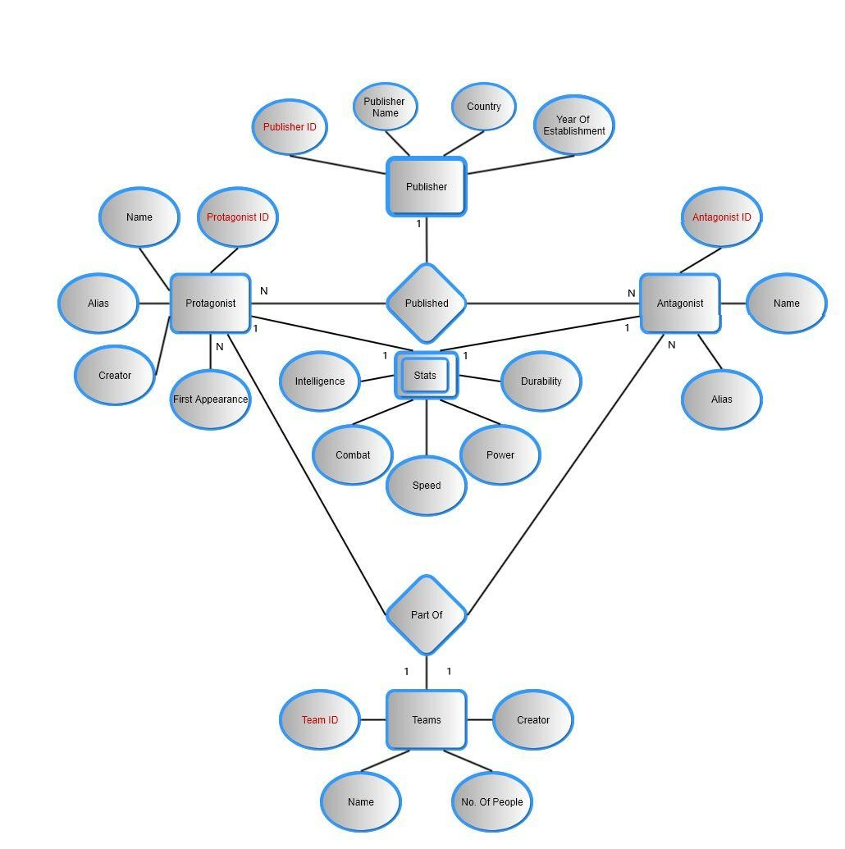
ER diagram

Slide 10
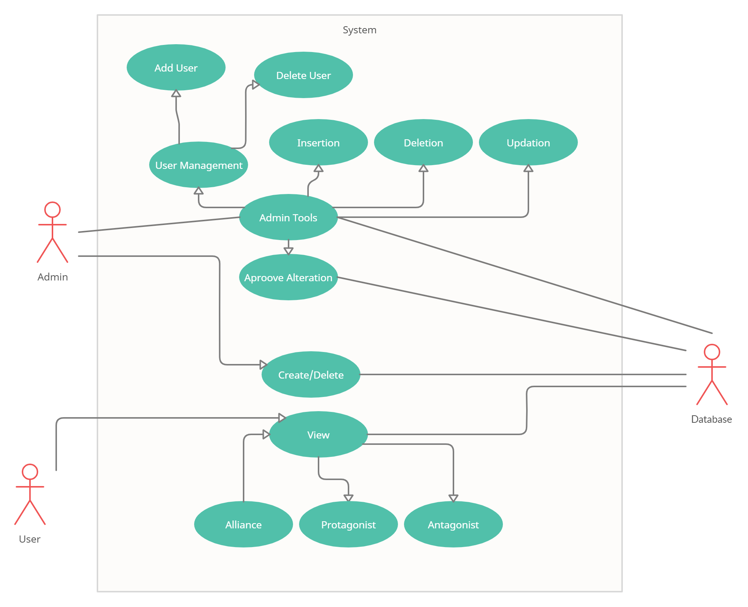
USECASE diagram

Slide 11
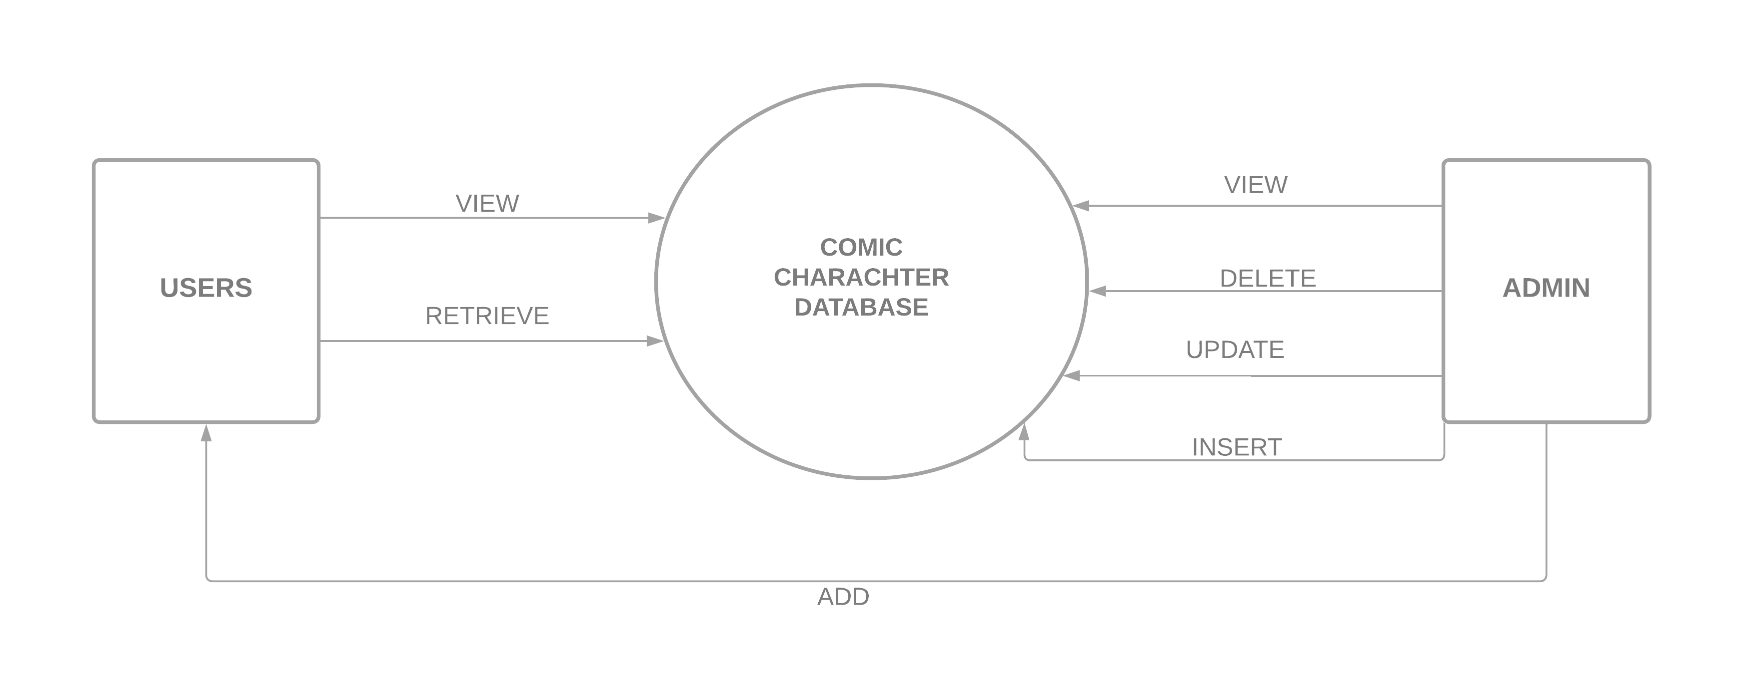
DATAFLOW diagram

Slide 12
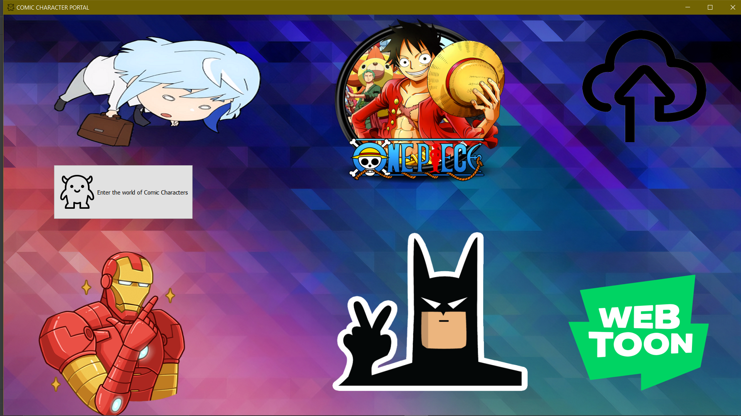
HOMEPAGE

Slide 13
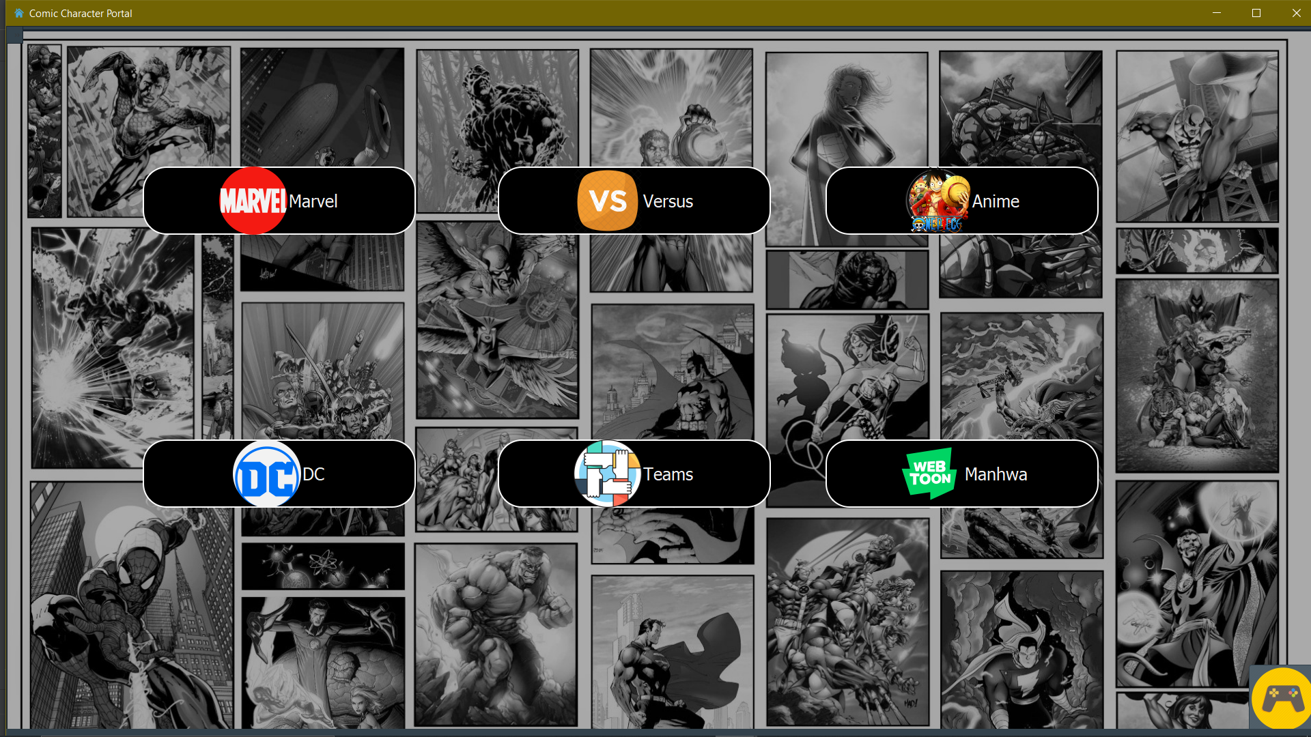
MAINPAGE
M

Slide 14
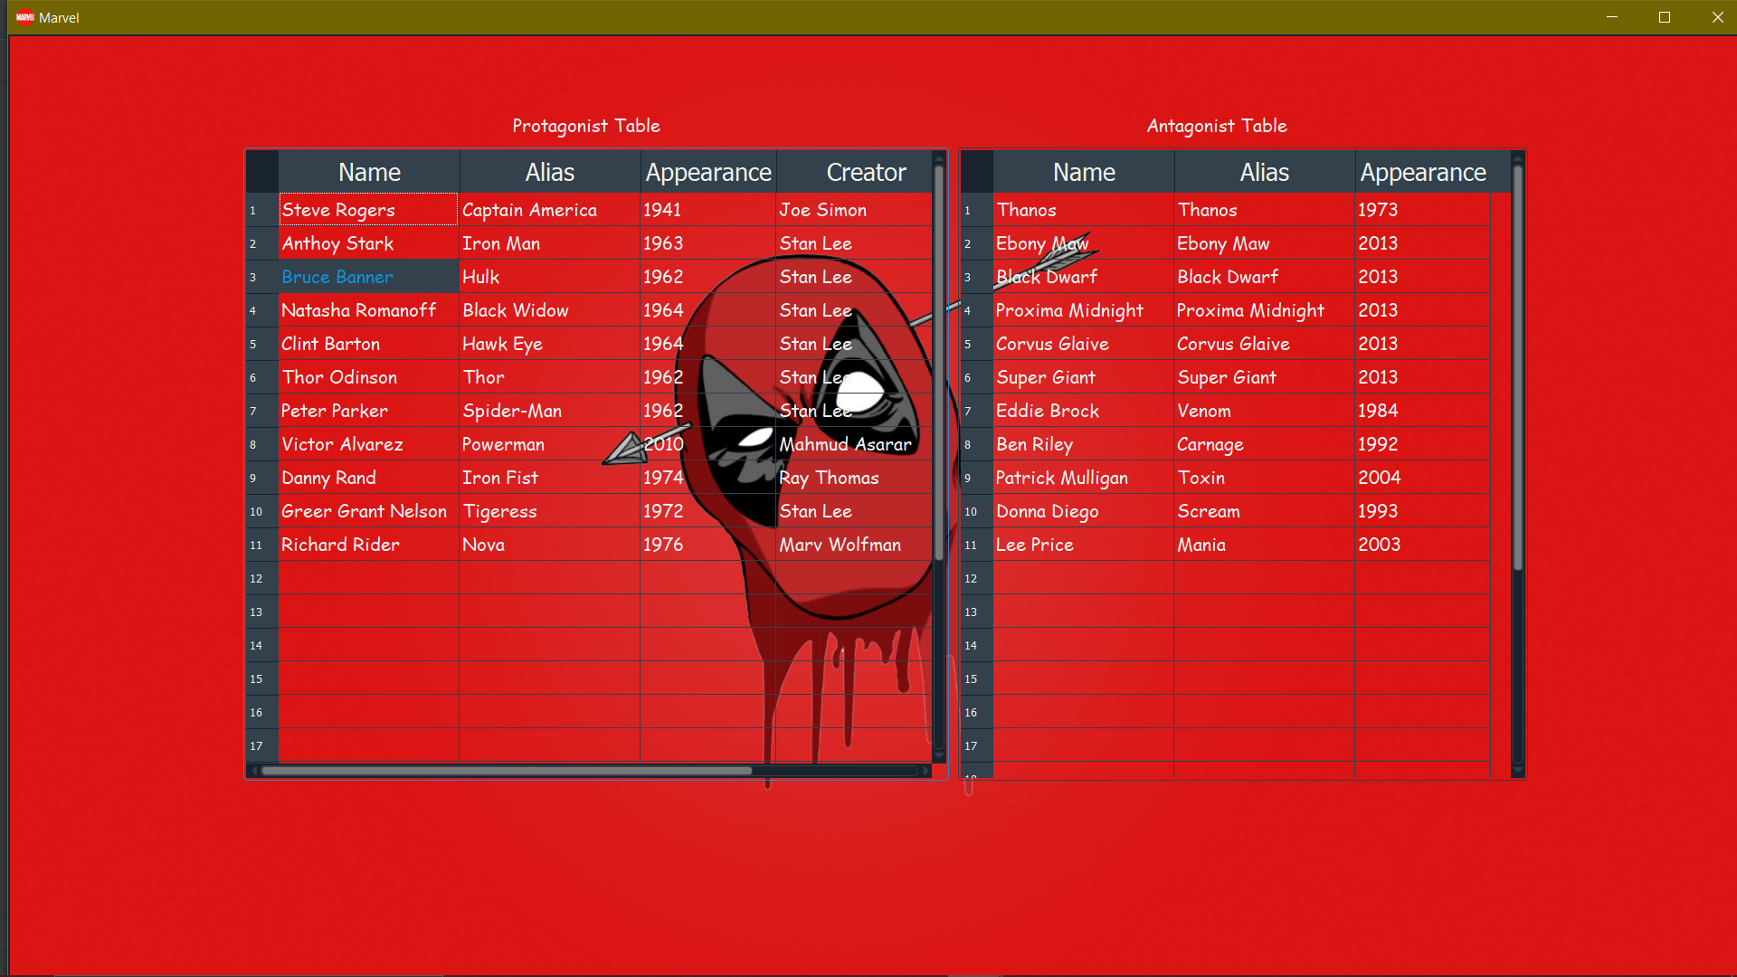
Marvel page showing information of both Protagonist and Antagonist

Slide 15
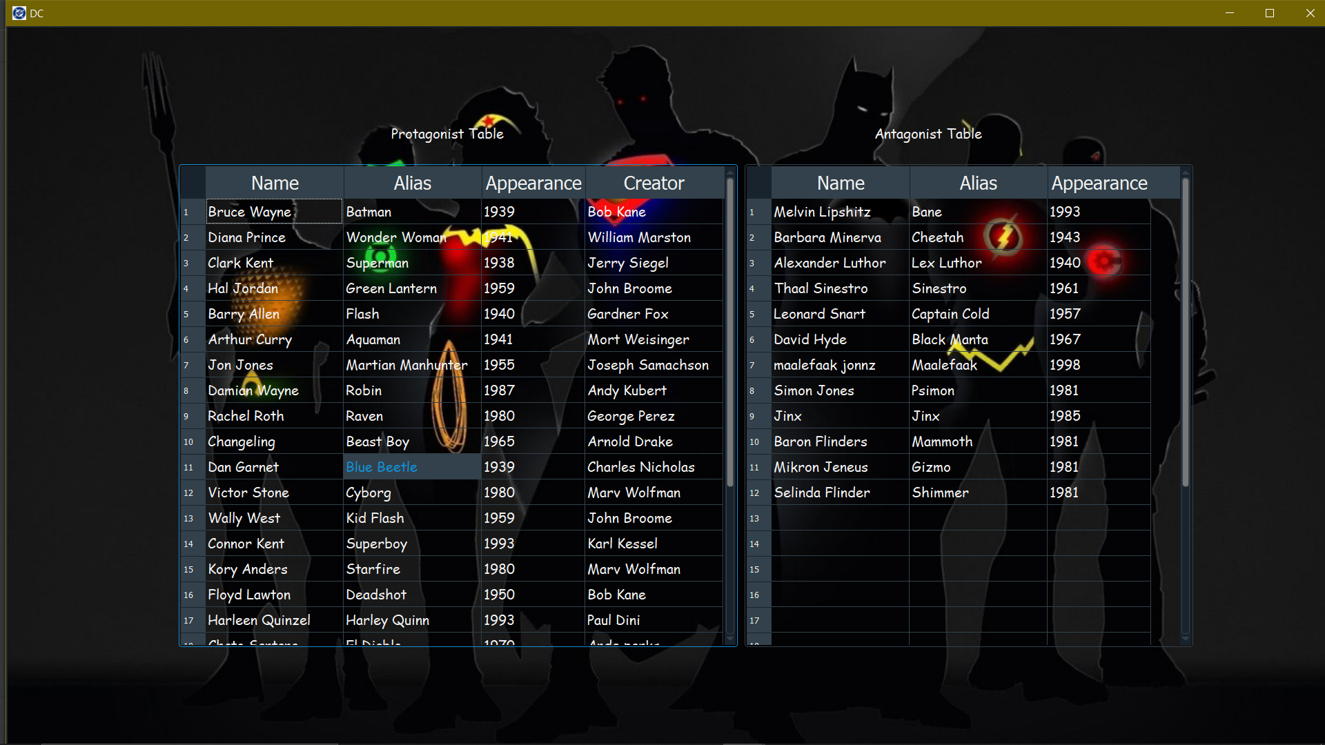
DC page showing information of both Protagonist and Antagonist

Slide 16
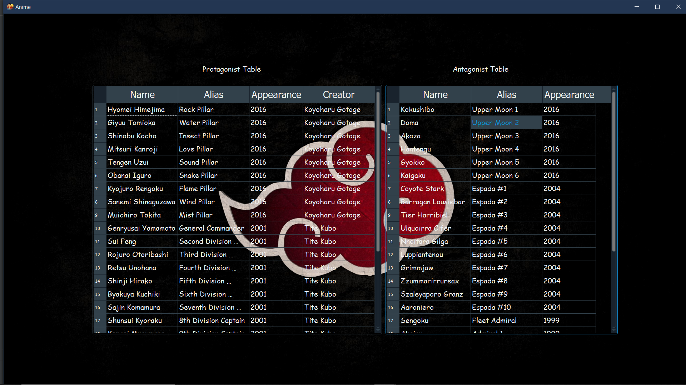
Anime page showing information of both Protagonist and Antagonist

Slide 17
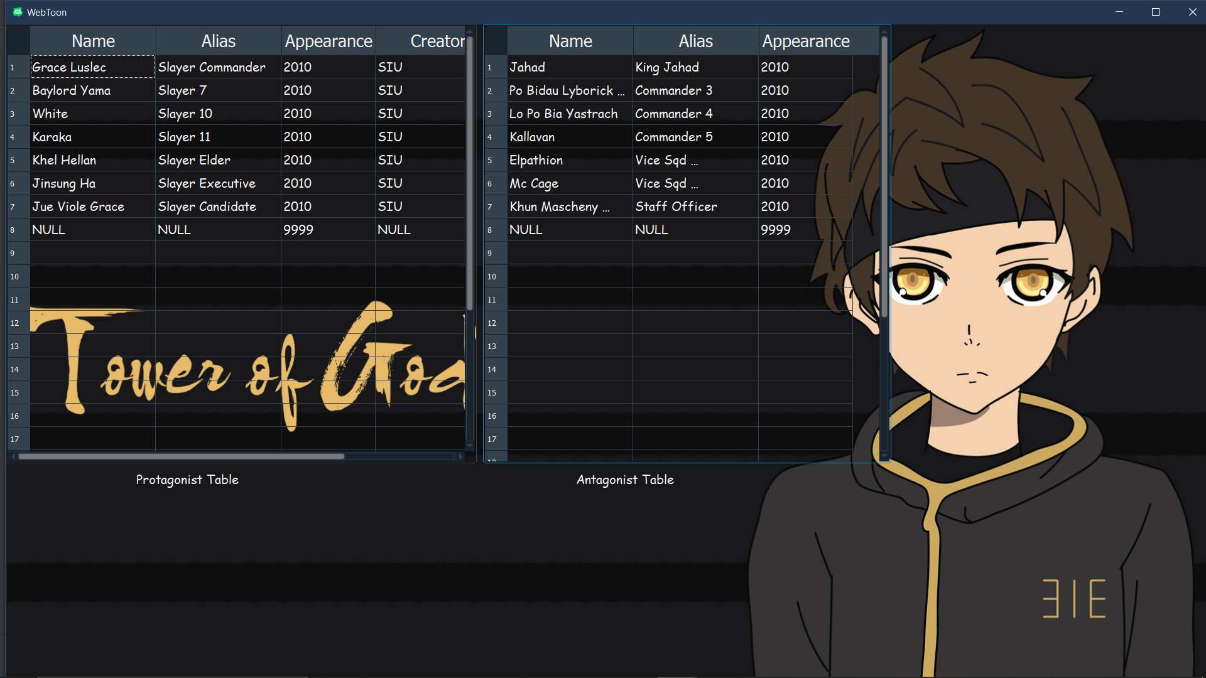
Webtoon Page showing information of both Protagonist and Antagonist

Slide 18
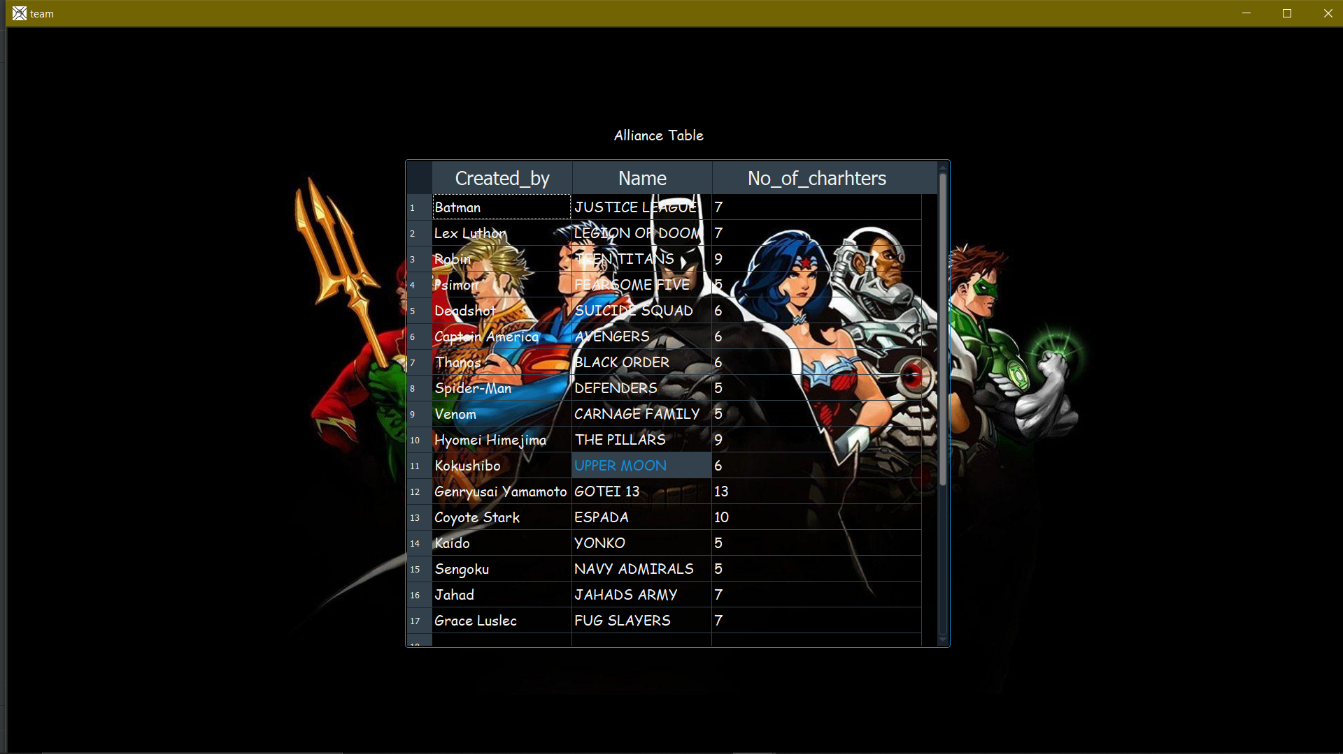
Showing information on teams
or alliance of characters.

Slide 19
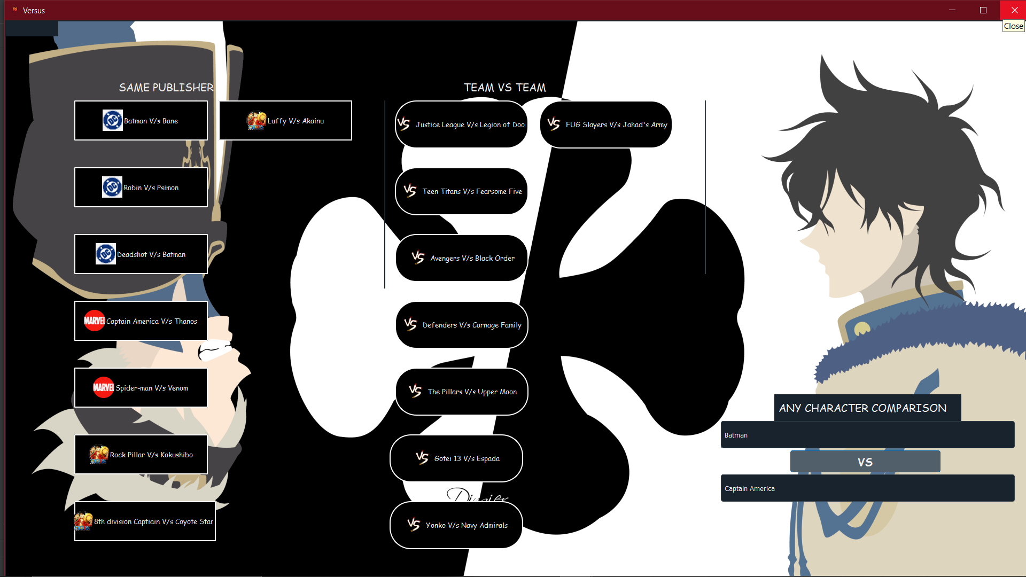
VERSUS page

Slide 20
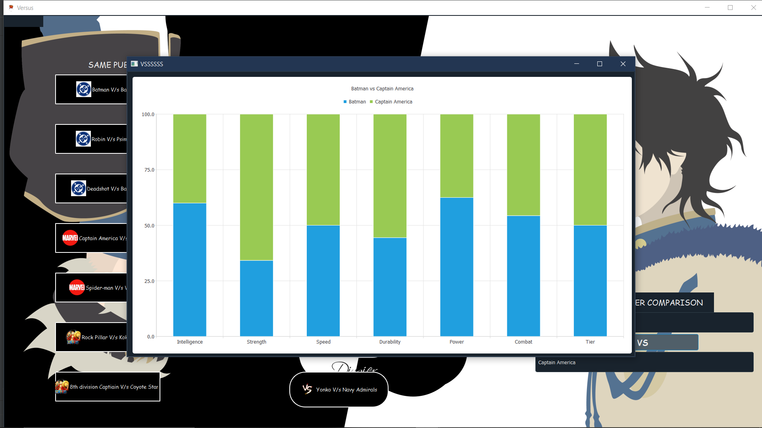
Comparison between 2 characters

Slide 21
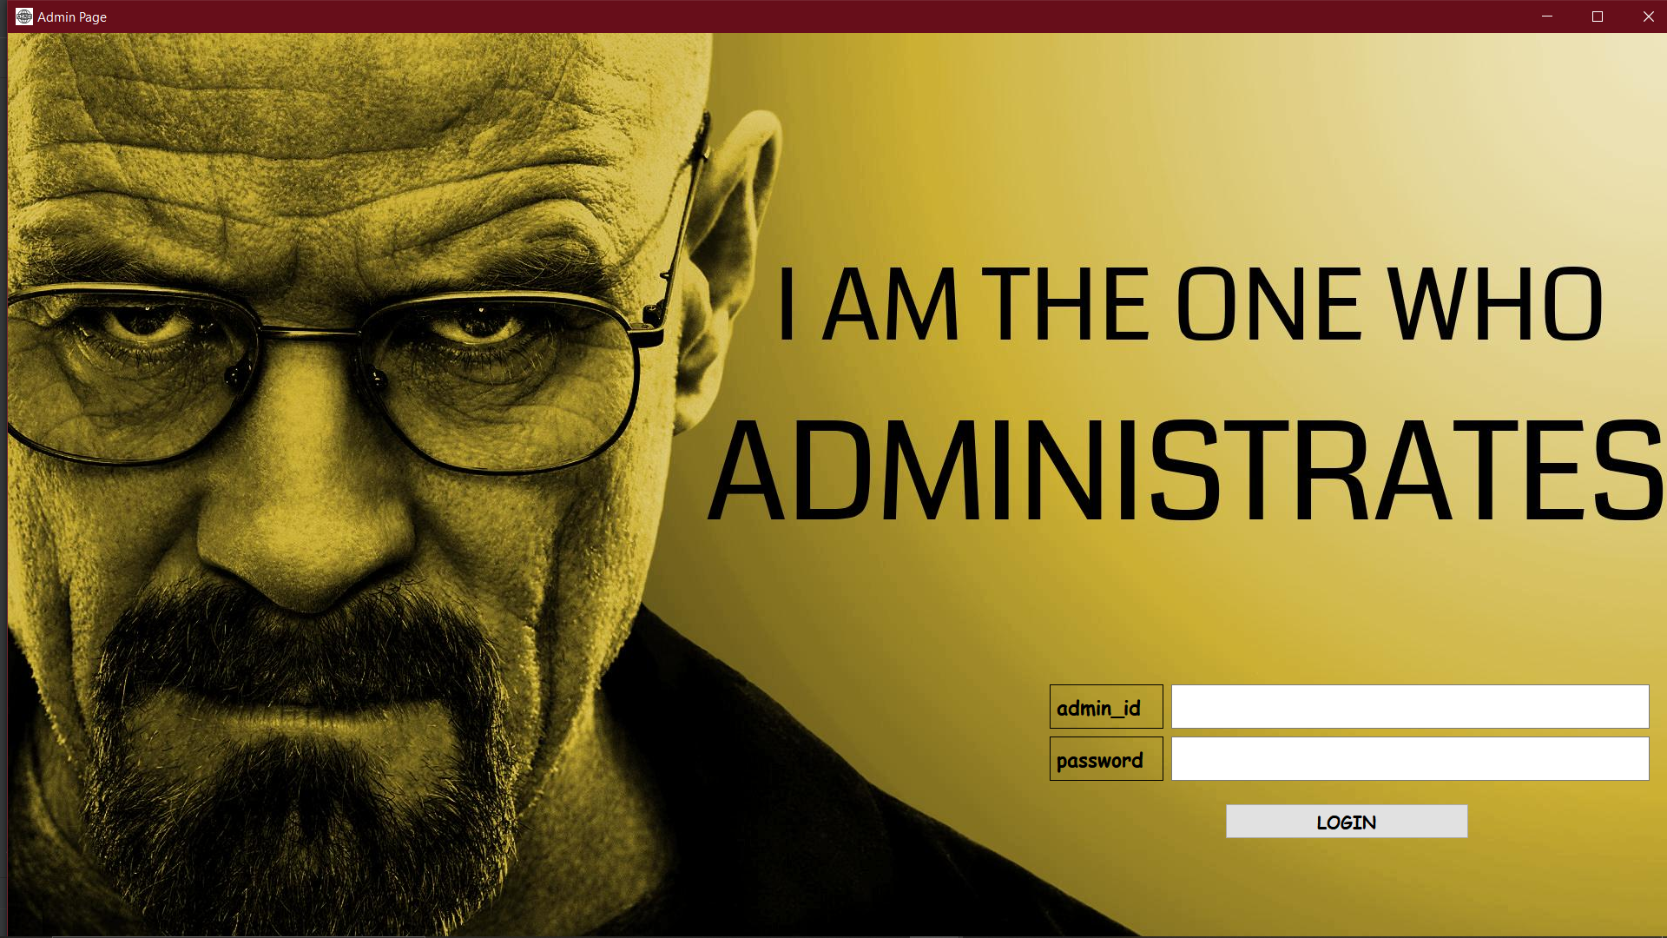
Pressing “Ctrl + Shift + a” on Main page
would open the Administrator login page

Slide 22
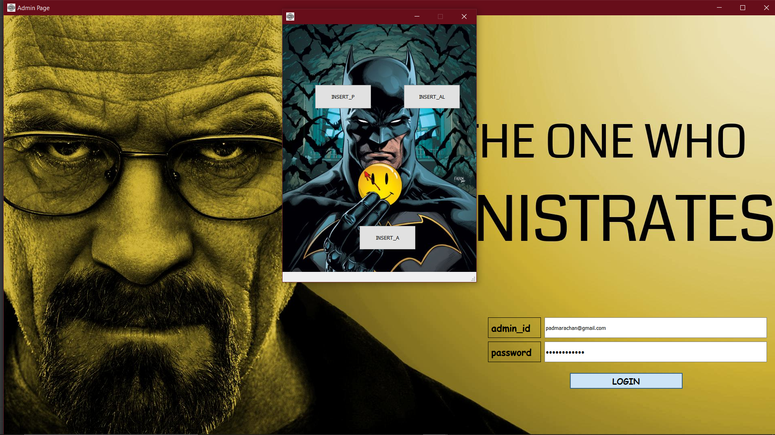
Correct login would open the administrator
Tools to insert values into database.

Slide 23
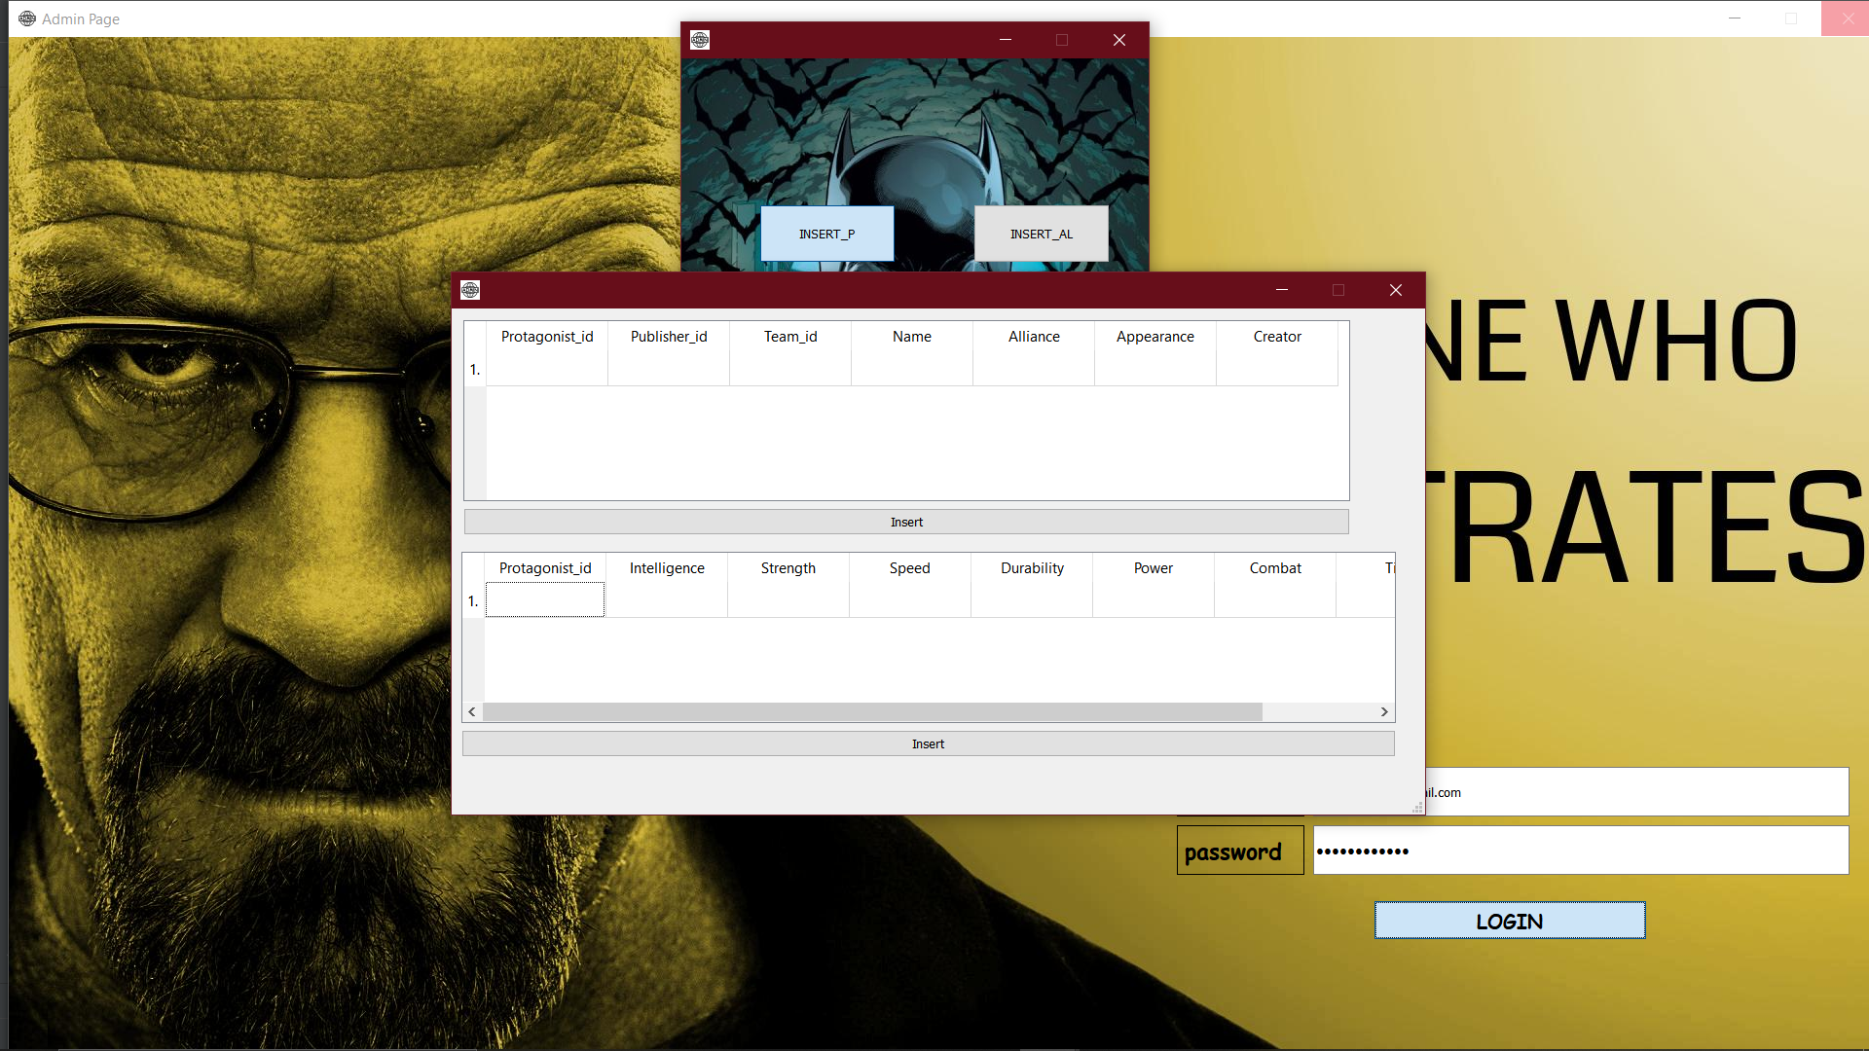
Inserting values using the pop up window on button click.

Slide 24
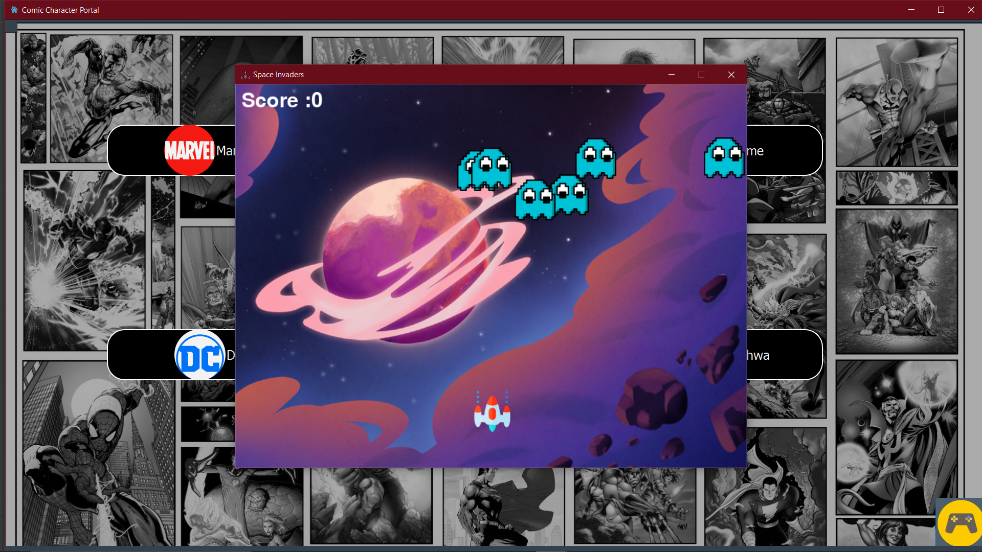
Play a game if boredom hits you hard..

Slide 25
THANK YOU
Mini Project By: K P Rachan
Yatharth S
Guided by: Asst Prof Suhasini

